Slide 1
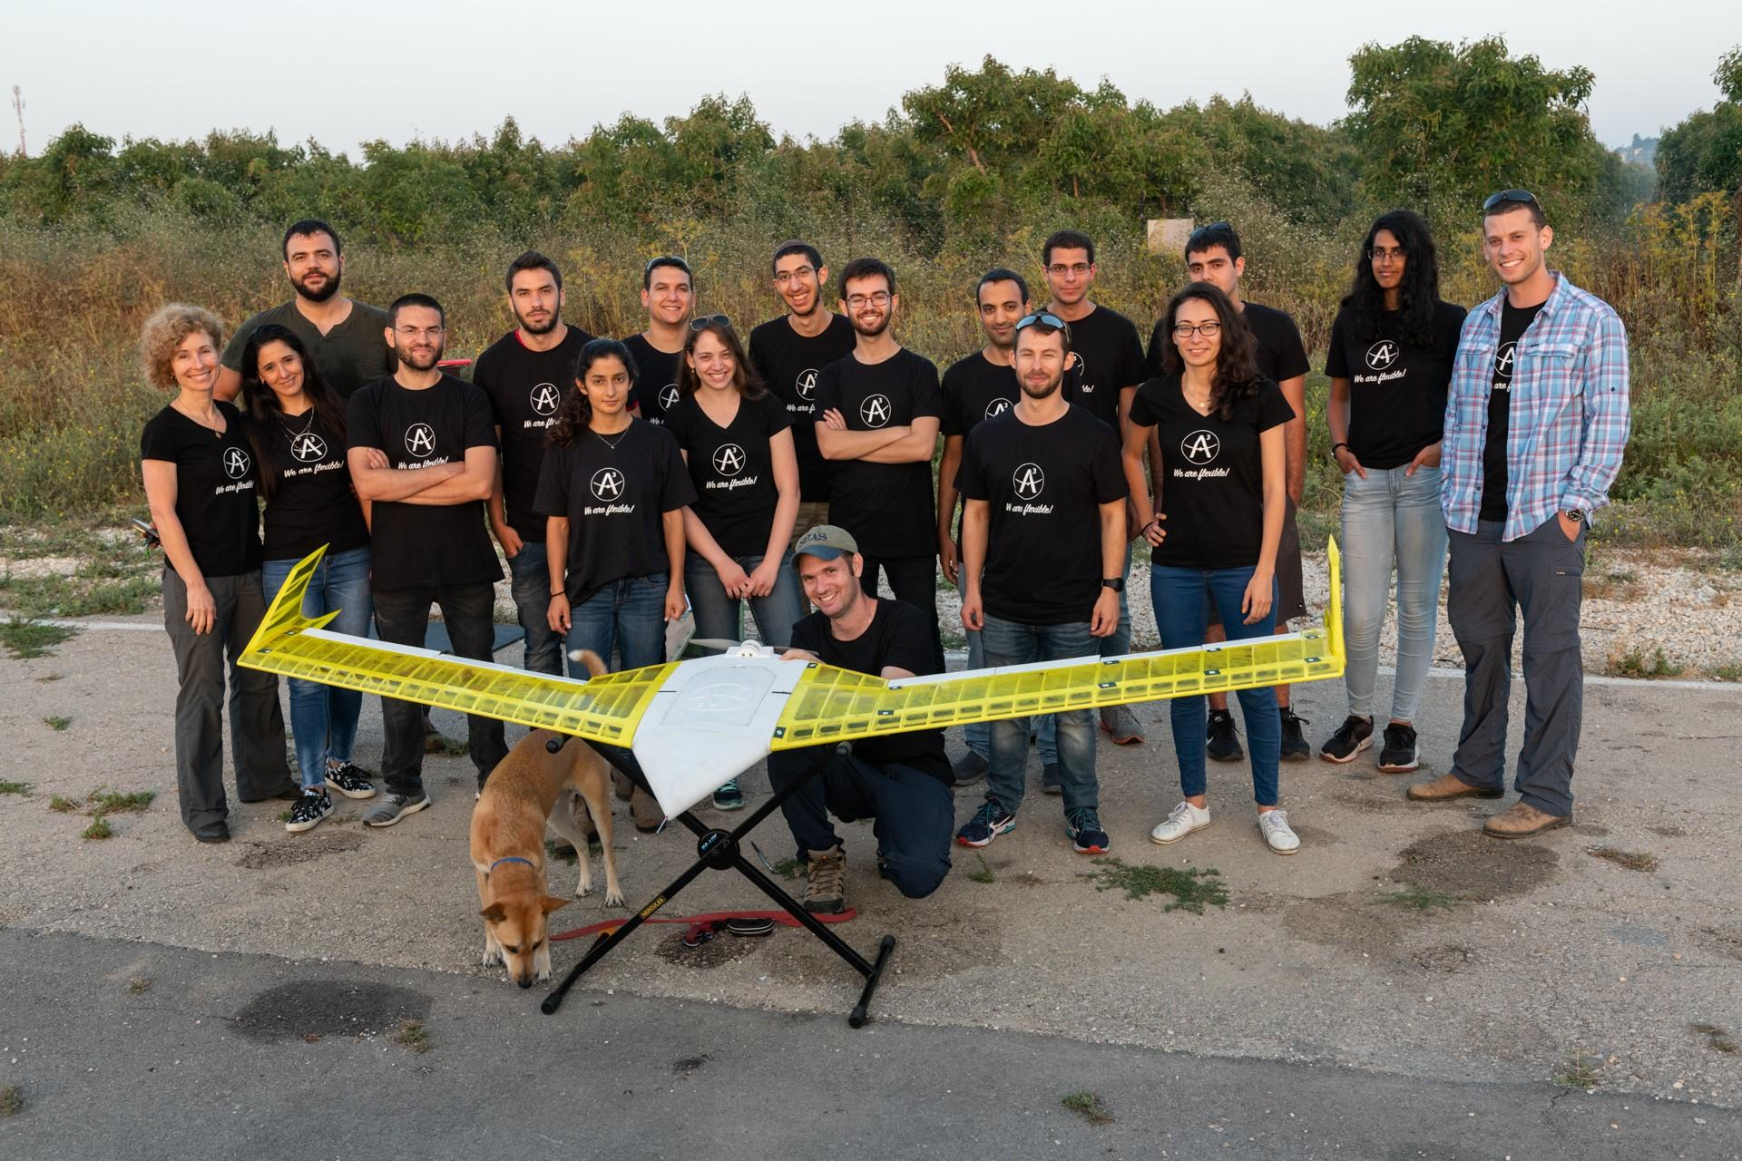
AeroVision

Slide 2
Theoretical
Background

Slide 3
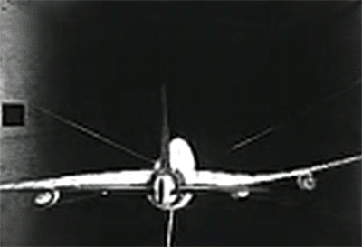
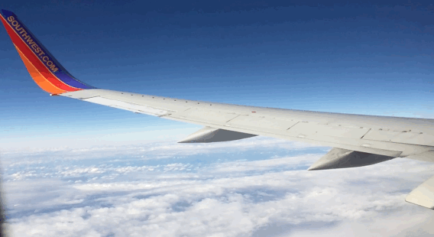
Theoretical Background
We want to control the wing’s shape, and in order to control it we need to calculate it
Notes:
-כנף זה לא גוף קשיח
-יש הרבה צורות לא רציות
-איך נחשב צורה

Slide 4
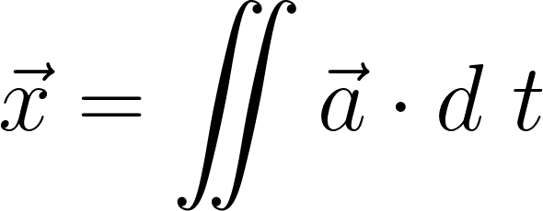
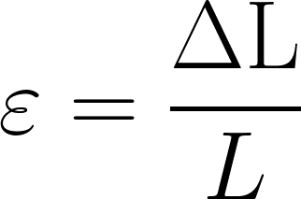
Theoretical Background
Integration
Integrating over acceleration to calculate displacement
Measuring strain
Measuring strain using optical fibers and receiving the displacement from there
Using mode shapes
This is the method we would use, explained more in detail over the next slides.
Notes:
כשאני מסיים לדבר על כל אחד

Slide 5
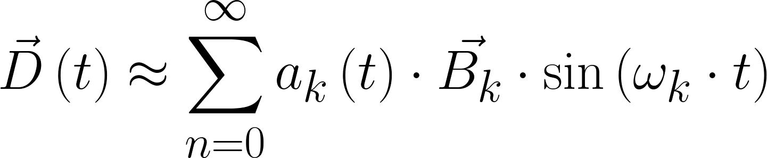
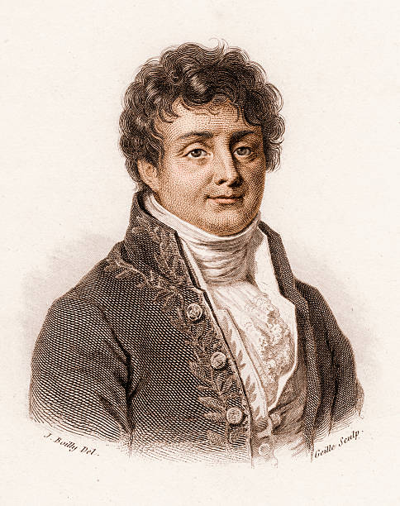
Theoretical Background
Modes (mode shapes, אופני תנועה)
An orthonormal basis for the shape of the system
Displacement
Scale
Mode Shape
Natural frequency of the mode shape
Notes:
-אחרי שאני מסיים לדבר על מה זה בסיס אוטונורמאלי או אומר פורייה
-מה כל רכיב אומר או שאני אומר בי קי

Slide 6
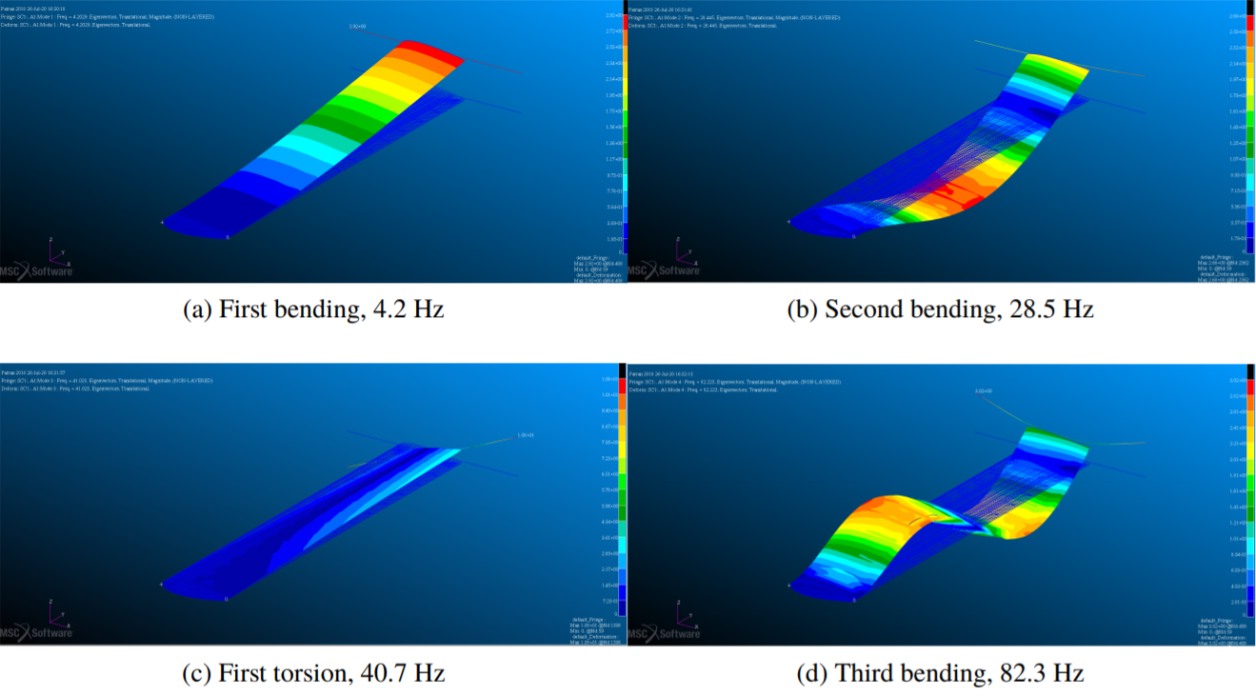
Theoretical Background
The mode shape are unique and constant for each system.
Mode Shape
Notes:
לדוגמא אפשר לראות את ארבעת המודים הראשונים של כנף (לא שלנו
וזה אותן מודים שחושבו מניסויים

Slide 7
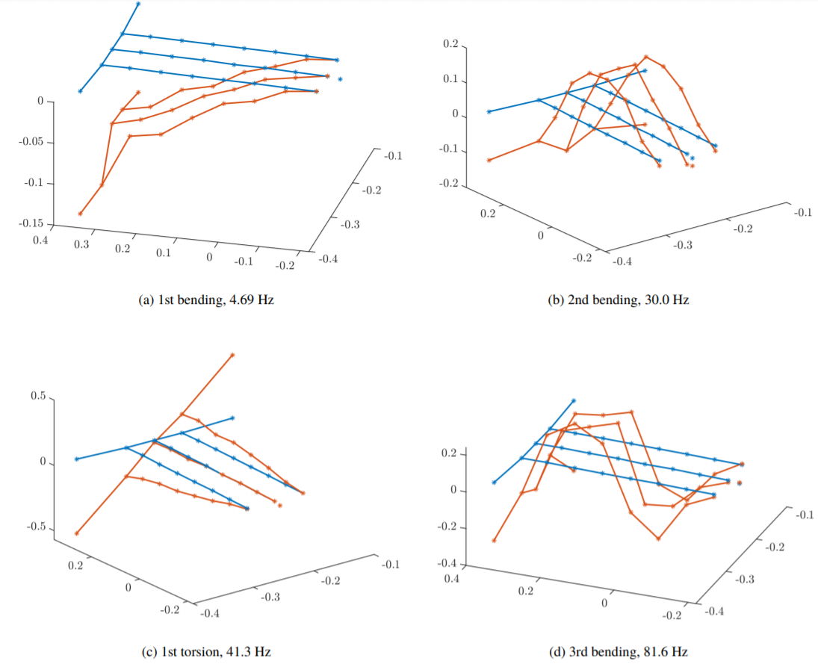
Theoretical Background
The mode shape are unique and constant for each system.
Mode Shape
Notes:
מה אנחנו מחפסים באמת

Slide 8
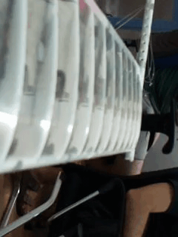
Theoretical Background
The scale is a scalar that determine how much each mode is represented in the movement.
Scale
The scales are independent, continuous and unique.
Notes:
מקדמים הם יחידים בלתי תלויים ורציפים
אפשר לראות שהמקדמים משתנים בזמן בצורה שלעין קשה להעריך

Slide 9
Goals

Slide 10
Goals
Create a system that is able to model the structure of the wing via cheap cameras and sensors in lab conditions and in wind tunnel conditions
Create a preliminary mobile system that is small enough to fit on a plane while mostly retaining the capabilities of the stationary system
2.

Slide 11
Schedule
&
Evaluation

Slide 12
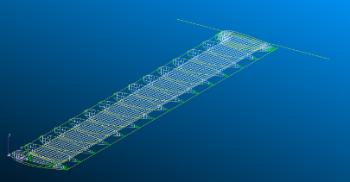
Schedule
Step 1 (~4 weeks)
Synthetic/Virtual Testing
Approximate setup determination
Step 2 (1-2 weeks)
Determine the final physical setup
Build the software required for data collection
Notes:
Step 1: Determining the optimal camera angles/setup and DL architecture/Classical solution
Step 2: Will require the Initial Data Collection setup
Middle of project is after stage 2

Slide 13
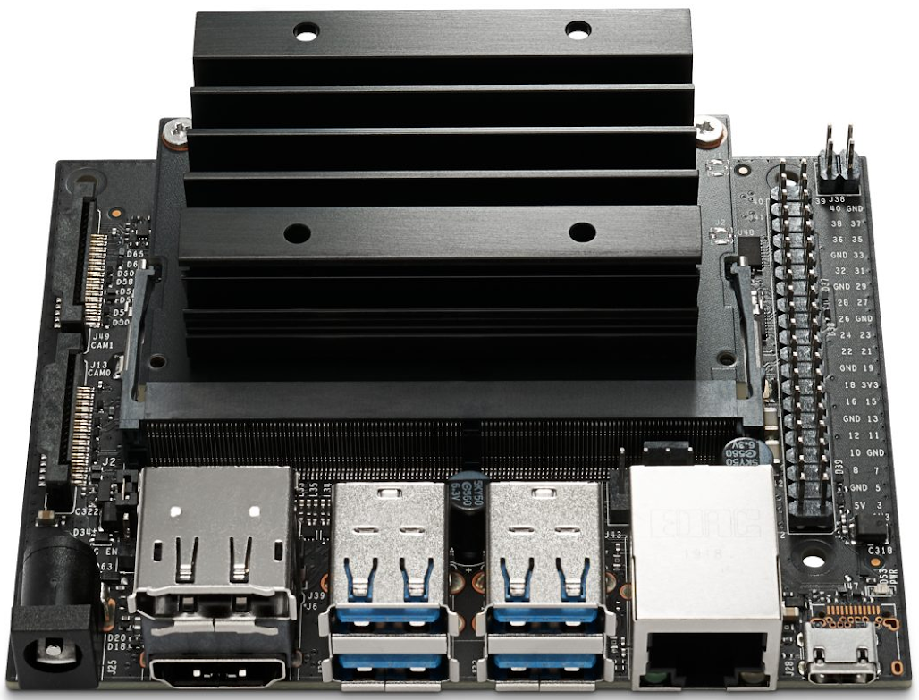
Schedule
Step 3 (~4* weeks)
Realistic Data Collection
Incorporating real world data into the system
Accuracy assessment
Step 4 (3 - 4 weeks)
Preliminary system mobilization
Notes:
Step 1: Determining the optimal camera angles/setup and DL architecture/Classical solution
Step 2: Will require the Initial Data Collection setup
Middle of project is after stage 2

Slide 14

Evaluation
Step 1:
Evaluation by comparison of the calculated modes to the theoretical model
Step 3-4:
Evaluation by calculating the L2 Loss between the 3D points measured with the IR cameras and the reconstructed points generated from the calculated modes
Notes:
Step 1: Determining the optimal camera angles/setup and DL architecture/Classical solution
Step 2: Will require the Initial Data Collection setup

Slide 15
Software
&
Hardware
Overview

Slide 16

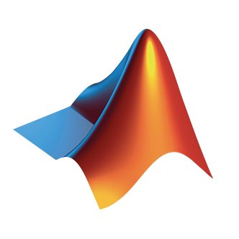
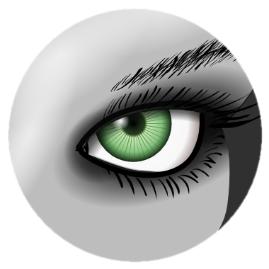
Software Overview
Python
MATLAB
MeshLab

Slide 17
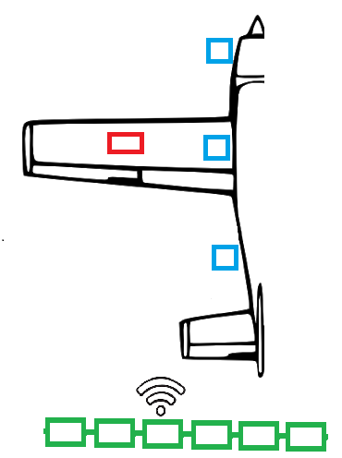
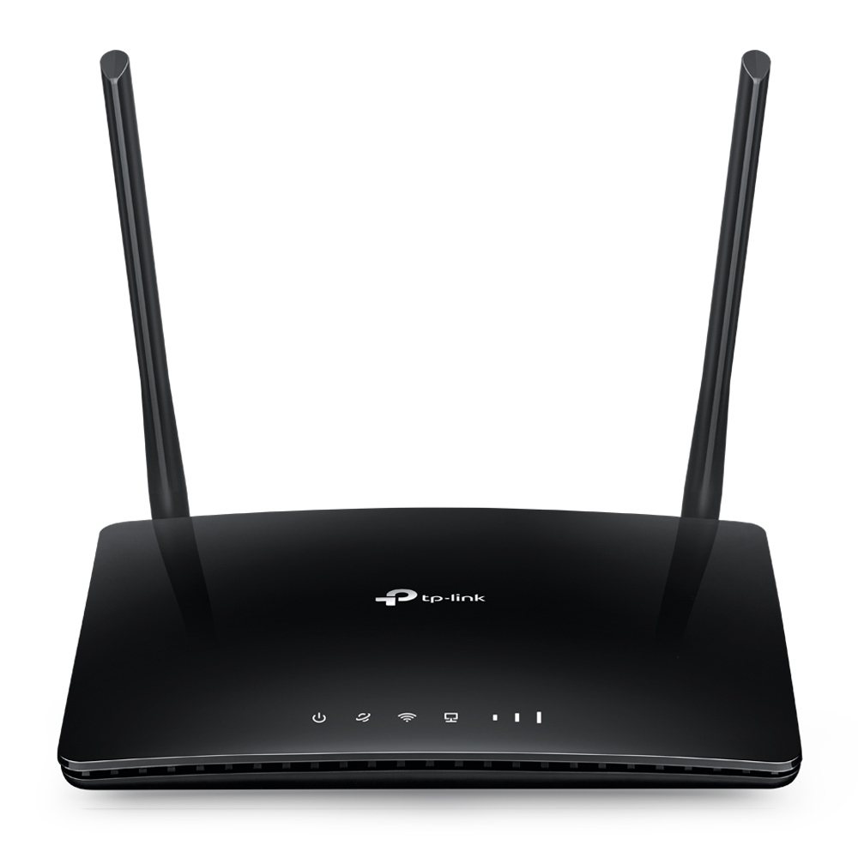
Hardware Overview
6x Cameras
1x Acceleration sensor
7x Raspberry Pis
1x Router

Slide 18
Pricing Summary
Data Collection (Initial) | 621.59 NIS
Data Collection (Full) | 2388.6 NIS
Edge Device Testing | 642.69 NIS
Total | 3031.29 NIS

